Slide 1
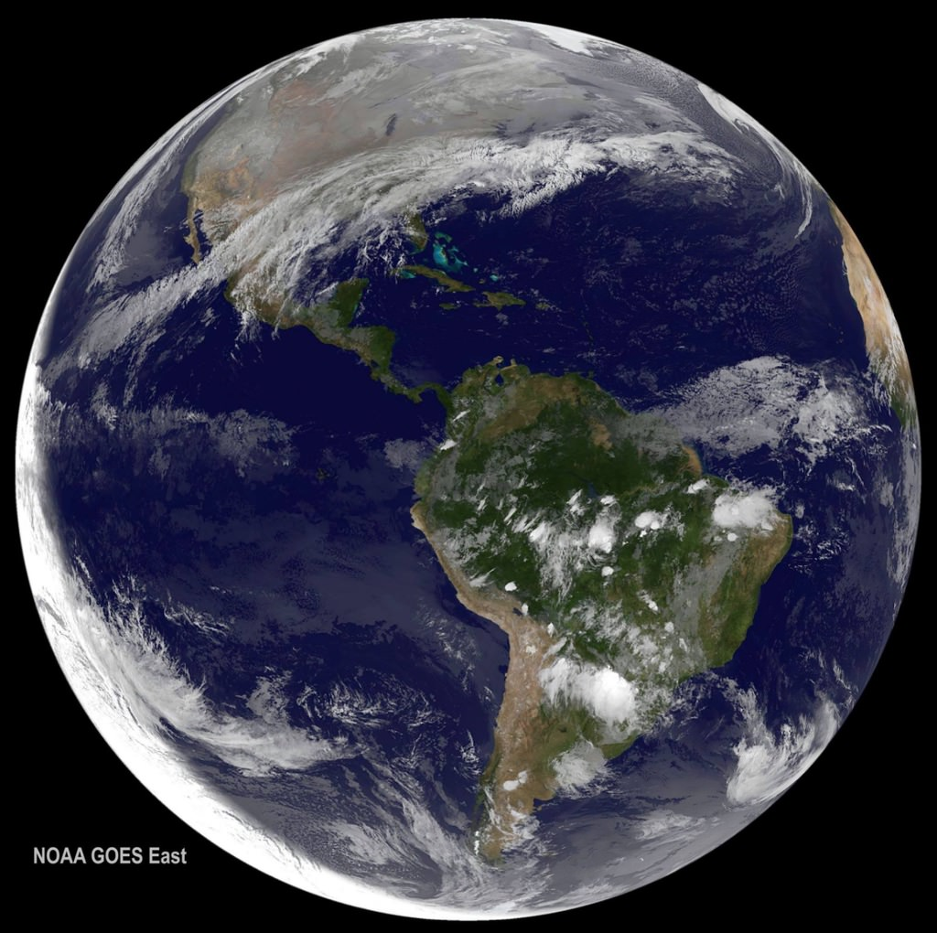
THE PLANET EARTH
This Photo by Unknown Author is licensed under CC BY

Slide 2
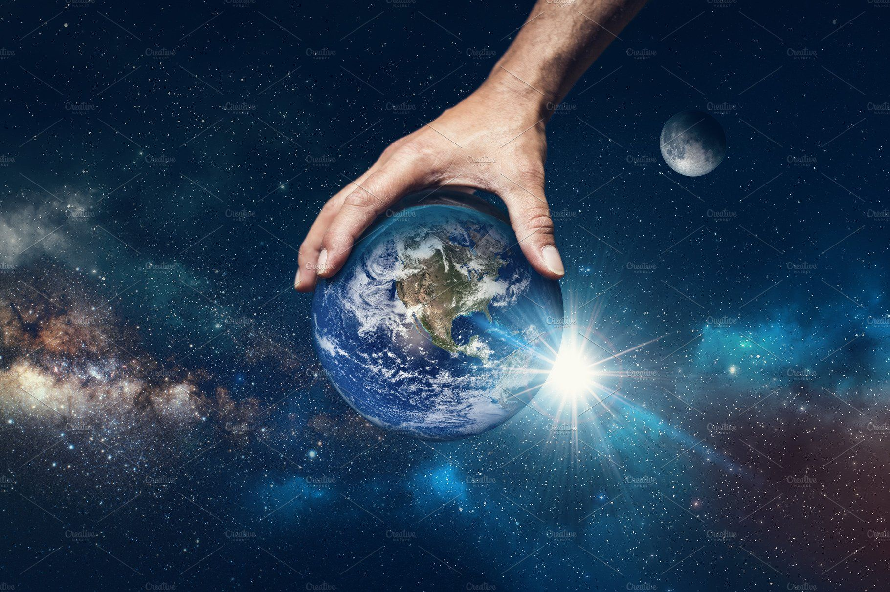
EARTH
Earth belongs to the milky way galaxy.
Earth is the only planet to be named in English.the word earth is old English word “land’’.
Earth is the only planet to sustain life.

Slide 3
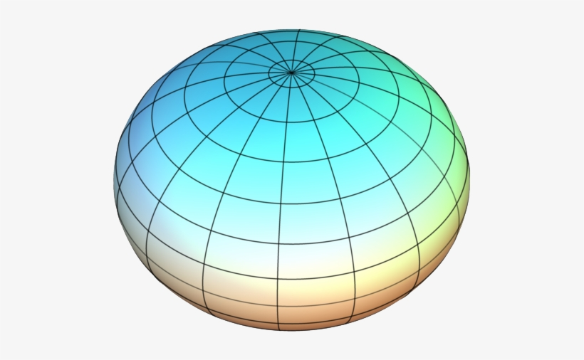
SHAPE OF THE EARTH
The study of size and shape of earth is called geodesy.
Before 500 BC, people thought that earth was flat. But thanks to scientist like Aristole and Pythagoras,people know that the shape of the earth is spherical.However sir issac Newton showed that the earth was not perfect sphere,but a compressed spheroid.
The true shape of the earth is called an Oblate spheroid.

Slide 4
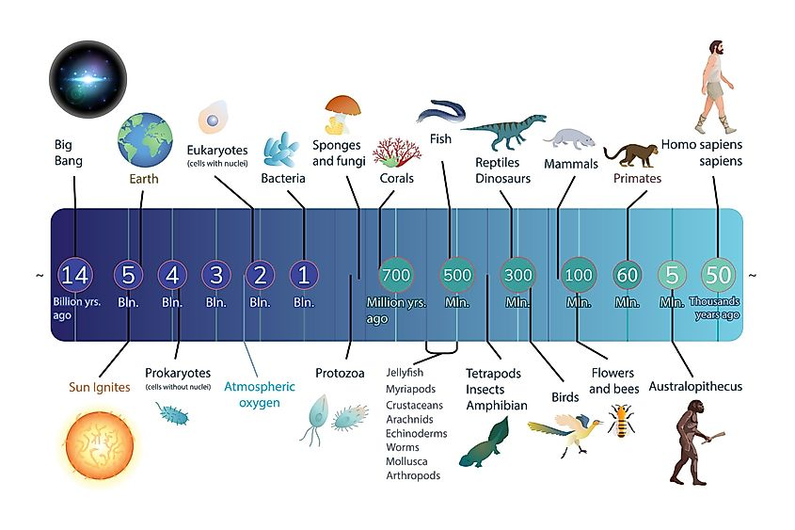
EARTH FORMULATION AND EVOLUTION
The earth formed over 4.6 billion years ago out of a mixture of dust and gas around
The young sun.
it grew larger thanks to countless collisions between dust particles ,asteroids and other
Growing planets,including one last giant impact that threw enough rock,gas and dust into
Space to form the moon.

Slide 5
STRUCTURE OF THE EARTHS INTERIOR
The structure of earth( also referred as cross –section )is divided into mainly crust
,mantle, inner core and outer core.
CRUST :
Outermost layer of the eart . It is also thesurface of the earth.
MANTLE:
About 1,800 miles (2,900km) thick .
The division between the crust and the mantle is called the mohorovicic
Discontinuity, or simply the moho.

Slide 6
CORE:
Earth core is about 4,400 miles (7,100km) wide
OUTER CORE- hot and liquid layer comprising mainly of nickel and iron (liquid).
INNER CORE – mostely made of soild iron and has little amounts of nickel .

Slide 7
ORBITAL CHARACTERISTICS
Earth’s orbit is not a perfect circle , but is rather an oval – shaped ellipse, like
That of the orbits of all the other planets.
Earth spins on an imaginary line called an axis that runs from the north pole to
The south pole,while also orbiting the sun.

Slide 8
MOTIONS OF THE EARTH
Rotation- rotation of the planet earth around its own axis.
The earth rotates on its axis from west to east or counter clockwise.
Revolution- earth’s movement around the sun
The earth revolves or goes around the sun in elliptical or oval orbit , from west
To east.
A year with 366 days is called a leap year.

Slide 9
AMAZING FACTS ABOUT THE PLANET EARTH
Earth was orginially born as a twin to the planet theia,which was about half as wide
As earth and roughly the size of mars.
The two planets shared an orbit for several million years until they collided.
Earth absorbed theia,and the remaining debris eventually coagulated into earth’s moon.
The mass donated by theia gave earth the gravity necessary to sustain a substantial
Atmosphere.

Slide 10

This Photo by Unknown Author is licensed under CC BY

